Slide 1
General Information

Slide 2
Global trends
Global demand for salt is forecast to climb 1.5 percent annually to 325 million metric tons in 2018, valued at $13.4 billion. The dominant Asia/Pacific region will be the fastest growing market. Trends in the production of chlor-alkali chemicals will continue to have the most significant effect on regional salt demand.

Slide 3
Global salt production, %

Slide 4
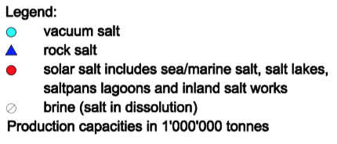
Production sites of Europe

Slide 5
Competitors (slide 1)

Slide 6
Competitors (slide 2)

Slide 7
What is salt used for?
INDUSTRIAL APPLICATIONS: Salt is the raw material for many chemical applications: production of glass, PVC*, paper, textiles, detergents and so on.
DE-ICING: Salt is a cost-effective de-icing agent that helps maintain our mobility and safety through winter. “Sensible salting” can limit damages to the environment.
WATER SOFTENING: Salt is used to reduce the hardness of water, thus increasing the energy efficiency of appliances.
FOOD & FEED: Salt preserves & gives flavor to food. Our body also need daily sodium intake to function properly. Salt is also used as a carrier for important micronutrients (iodine, fluoride, folic acid).
*Note: Polyvinyl chloride, more correctly but unusually poly, commonly abbreviated PVC, is the third-most widely produced synthetic plastic polymer, after polyethylene and polypropylene. PVC comes in two basic forms: rigid and flexible

Slide 8
European Salt Producers Association
http://eusalt.com/

Slide 9
Danube Ports
http://www.danubecommission.org/index.php/ru_RU/porty-na-dunae

Slide 10
Food-grade Salt
Salt is an essential component of human nutrition. That is why it also plays an important role in food production and processing, especially as a spice and preservative.
A certified and guaranteed quality is indispensable today. Food-grade salt can be supplemented with numerous active substances, for example iodine or fluoride. Herbs, other spices and flavourings can easily be added to salt.
esco offers the food industry numerous rock salt and vacuum salt products.

Slide 11
Animal Nutrition
Animal nutrition salt is used as raw material for industrially produced feed mixes or as ready-to-use nutritional supplement in breeding. It represents the basis for health and fertility and supports performance and stamina of the animals.
The esco nutrition salts fulfil high standards and are manufactured according to high quality standards and strict safety and animal health aspects. They are suitable both for conventional and biological agriculture.
From summer 2015 on, esco offers the seamless GMP+ certification for feedstuffs, from extraction through production and storage to subsequent transport by ship - transport by road or rail are included in the certificate

Slide 12
Feed salt
Animals in the wild look for their salt sources in nature and take care of the balance in their sodium retention themselves. Breeding animals need sodium to balance a lack due to insufficient sodium content of the usual fodder plants. Feed salt helps digestion, physical development and well-being of the animals.

Slide 13
Water Softening
Soft water is necessary for numerous industrial processes, but also in private households. Water hardness varies from region to region, so that special treatment is necessary to obtain soft water.
The principle of water softening has proven to be increasingly successful over the past years and achieves hygienic results for the highest water demands. The hardness components calcium and magnesium are removed from the water by the ion exchange method.

Slide 14
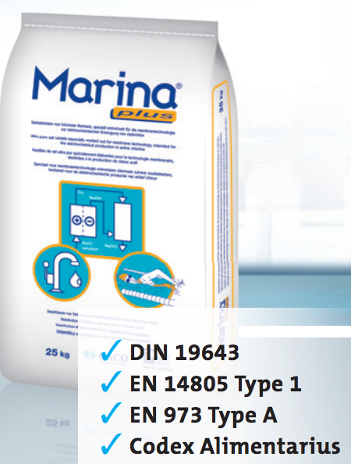
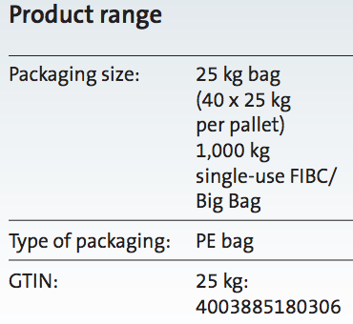
Swimming Pools
Drinking water treatment and disinfection of water in swimming pools have gained in importance. Salt is used for electrolysis (chlorination) in public swimming pools, wellness facilities and private pools to disinfect the water and to prepare pool brines.

Slide 15
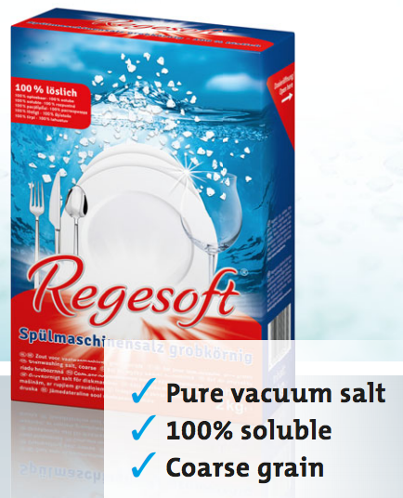
Dishwasher Salt
Dishwasher salt is a compacted vacuum salt. It is used in dishwashers. Filled into the provided container, this product, which is also called regeneration salt, is required so that the ion exchanger of the machine can soften the water. This increases the cleaning efficiency, which in turn provides shiny results for the wash and protects the dishwasher against calcium deposits.

Slide 16
Pharma Salt
Pharma salt is an important basic material in the pharmaceutical and medical industry. With the help of pharma salt, numerous medications, dietetic food as well as cosmetics, care and wellness products are produced, in addition to dialysis and infusion solutions.
From the pharmaceutical and chemical point of view, pharma salt has a particularly high, very pure quality. esco produces pharma salt from high-purity vacuum salt without additives.
Pharma salt is a sodium chloride, which, from the medical-pharmaceutical and chemical point of view has a particularly high, very pure quality. In the pharmaceutical and medical industry, pharma salt is an essential base substance. It is used for the production of cosmetic, care and wellness products, enteral and parenteral infusion solutions, dialysis solutions, medication, dietetic food as well as for other pharmaceutical applications.

Slide 17
Industrial Salt
Industrial salt is used in numerous areas of industry and trade, for example in the production of paints, leather processing or the production of textiles. esco offers a comprehensive range of industrial salts made of rock or vacuum salt for the various applications.
esco industrial vacuum salt is a product of extremely high purity that is completely soluble. In the crystalline form it is available in the usual grain sizes from extra fine to coarse.
esco industrial rock salt offers a broad spectrum of granulation and grain sizes which are tailored to customer’s needs.

Slide 18
Fishery Salt
The history of salt is closely linked to the development of fisheries and fish processing. The probably most well-known connection to salt is the dried cod. What is considered a delicacy these days used to be a reliable and durable basic food in past centuries.
Even today, salt is an indispensable preservative by dry as well as wet salting, and an important spice in marinades and fish processing.

Slide 19
Salt for Sausage Casings
Salt plays a major role in the first treatment of animal casings for the meat processing industry. Fresh animal casings need to be processed with a high-quality, pure salt to prepare them optimally for further processing.
Rock salt is mainly used for the preservation of animal casings because it liquefies more slowly than vacuum salt.

Slide 20
Special Hide Salt
Special hide salt is used for the first treatment of animal hides and skins as well as when tanning leather. Sodium chloride preserves freshly skinned pelts, dehydrates them, inhibits any bacterial growth and prevents decay reliably. It also prepares the valuable material for further processing.

Slide 21
Industrial Salt as Dye-enhancer for Textiles
In the textile industry, industrial salt as dye-enhancer for textiles is used during the manufacture, processing and refining of fabrics and materials, such as for example, dying cotton or the printing of materials. Industrial salt as dye-enhancer for fabrics ensures that the colour fully penetrates the fabric and is better bound and looks after the corresponding dyeing process.

Slide 22
Industrial Salt for Drilling Fluids
Salt is an important basic material which is used when drilling for other natural basic materials such as crude oil and natural gas, for example, in the drilling muds. The requirements of the drilling industry are high and very specific so that, depending on demand, either rock or vacuum salt in various qualities is used.

Slide 23
Pond Salt
pond salt is a high quality, very pure rock salt in a special grain size which is particularly suitable for the application in fresh water and ornamental fish ponds as well as in ornamental fish aquariums.

Slide 24
Electrolysis
During the chlor-alkali electrolysis, salt (sodium chloride - NaCl) is separated into its components chlorine and sodium.
The sodium part is further processed in various derivatives, for example as soda lye or caustic soda, as well as sodium hypochlorite. Chlorine is used in many applications. Its largest application area is the manufacture of plastics such as polyvinylchloride (PVC), polycarbonate or as intermediate product isocyanate (MDI) in polyurethane synthesis.
For the highest requirements of the various electrolysis technologies, esco offers a great number of rock and vacuum salt qualities.

Slide 25
Brine
Brine is either a natural salt water spring or a solution produced from salt dissolved in water. Brine is used in various concentrations for numerous applications, for example as de-icing agent, in the chemical industry in water softening, in swimming pools, aquariums and delphiniums.

Slide 26
ARTYOMSALT

Slide 27
AS certificates

Slide 28
AS prices as on 23.04.2015
Note: Ціна на продукцію ДП "Артемсіль", що відвантажується споживачам Австрії, Німеччини, Скандинавії, Чехії та Словаччини, Польщі, Угорщини, Болгарії на умовах DAF, CPT

Slide 29
Top 10 regular countries-consumers of AS’s salt

Slide 30
Irregular countries consumers of AS's salt

Slide 31
Top 10 countries-consumers during the years

